Slide 1

G H Raisoni College of Engineering, Nagpur
Date : 1st Oct 2022
Department of Artificial Intelligence
Project Phase –I Progress Seminar
Winter 2022 (Session: 2022-2023)
Cyber Trolling Detection System
GROUP NO – 19
Presented By:
Saurabh Barse(A-54)
Yash Solanke (A-64)
Dikesh Kurve (A-31)
Guide:-
Prof D Bhagat
GHRCE ,Nagpur

Slide 2
Proposed Methodology/System Architecture
Architecture pipeline
Data Collecting
Applying EDA
NLP Pipeline
Phase 2
Develop UI/UX
Applying ML/DL Model
Flow of all phases

Slide 3
Data Gathering
We had gathered a data set from various sources or to be precise from websites like data.world ,Kaggle, GitHub repos and large portion of the data from web- scrapping (from social media like twitter) this collected data consist of various languages like English, Hindi. Our main goal was to collect the data which represents more reality towards the real-life situation. In the data gathering we mostly depend on web-scrapping .

Slide 4

Organizing tasks with Git and GitHub
For Organizing and tracking our final year project we are using Git and GitHub for version control and organizing the code which leads to smooth movement of our machine learning and deep learning pipelines. We believe in adapting proper and structured approach for our final year project. We had uploaded our overall progress like dataset and code in GitHub repository to maintain a structured flow of our project.
Link for GitHub

Slide 5
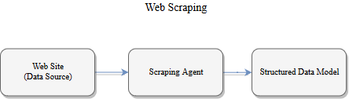
Web-scrapping pipeline
In the Web-scrapping we use a various agents like Beautiful soup, snscrape for scrapping purpose. Our web scrapping is done mostly on twitter platform . Scrapping is done on basis of “#tags” like “#vaccine”,”#metoo” and etc. Our main aim is to gather more realistic data to train our model more rigorously which leads to correct predictions of model.
=
Flow of web-scrapping pipeline

Slide 6
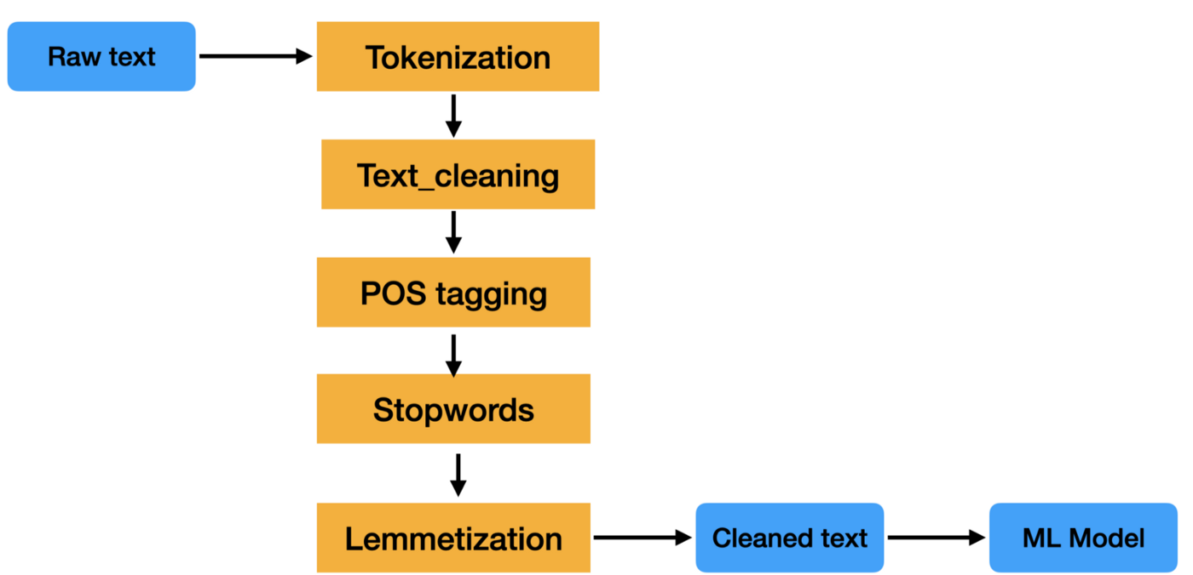
Work in Progress
=
After collection of Data we are initiated the Exploratory Data Analysis (EDA) with Natural Language Processing(NLP) phase . In which processing of data like cleaning collected data, Removing noise from data, removing emoji’s , gibberish text and etc are to be done. Some visualization techniques are also going to used for better understanding of data. Following stages we are applying in NLP pipeline.
NLP pipeline flow cycle

Slide 7
References
Hatred and trolling detection transliteration framework using hierarchical LSTM in code-mixed social media text:-https://link.springer.com/article/10.1007/s40747-021-00487-7
Multimodal Sentiment Analysis on Video Streams using Lightweight
Deep Neural Networks https://www.scitepress.org/Papers/2021/103044/103044.pdf
Emotionally Informed Hate Speech Detection: A Multi-target Perspective
https://link.springer.com/article/10.1007/s12559-021-09862-5
ETHOS: a multi-label hate speech detection dataset
https://link.springer.com/article/10.1007/s40747-021-00608-2

Slide 8
Thank You…..

